Slide 1
Artificial Intelligence
Lecture 5 Playing games
Playing games

Slide 2
Outline
Games and AI
Perfect play
minimax decisions
α–β pruning
Resource limits and approximate evaluation
Games of chance
Games of imperfect information
Playing games

Slide 3
Games vs. search problems
Adversarial search: our first example of a (competitive) multi-agent setting !
“Unpredictable” opponent ⇒ the solution is a strategy that specifies a move for every possible opponent’s reply, not a single action
There are time limits ⇒ we are unlikely to find a goal each time and must approximate by making decisions
One of the first AI problems studied:
First chess program to use game search (Turing, 1951)
Machine learning to improve evaluation accuracy (Samuel, 1952)
Pruning to allow deeper search (McCarthy, 1956)
Playing games

Slide 4
Types of games
 | deterministic | non-deterministic (chance)
perfect information | chess, checkers, Go, Othello | backgammon, Monopoly
imperfect information | battleships, blind tic-tac-toe | bridge, poker, Scrabble, nuclear war
Playing games

Slide 5
Two-player, fully observable, zero-sum games
Players are commonly called min and max
players take turns (each turn is called ply)
make one move at each turn
The game is zero-sum: one player’s loss is another player’s win
Total reward is fixed, to be divided between players.
Example: chess, checkers, Go, Othello
All possible plays can be described by a game tree
root contains the initial position of the board
nodes in levels are labelled with min and max (alternating on next level)
usually max makes the first move
leaves are labelled with a utility function value (from max’s point of view) - e.g., wins are labelled with +1, draws with 0, and losses with -1
Game tree can be used to identify an optimal strategy
determines the outcome of the game even without playing!
Playing games

Slide 6
Game tree
MAX (X)
X
 | X
 |  | X
X
 |  | X
X
 | X
 |  | X
MIN (O)
X
X
O
X |  | O
X
O
. . .
MAX (X)
X
O
X
X | O
X
X | O
 | X
. . .
MIN (O)
. . .
. . .
. . .
. . .
X | O |  | X
O | O |  | X
X | X |  | O
X | O |  | X
 | X
X | O |  | O
X O X
O X
. . .
TERMINAL
O
Utility
−1
0
+1
Playing games

Slide 7
Optimal Strategies
In a search problem, the optimal solution is a sequence of moves leading to the goal.
In a game, the agent must find a contingent strategy specifying
The first move in the initial state of the game,
The moves in the states resulting from each response to his moves by the opponent, and so on. . .
Optimal Strategy: leads to outcomes at least as good as any other strategy
Perfect play for deterministic, perfect-information games where it guarantees winning strategy, applicable even when one is playing with an infallible opponent
Will be using it also in more complex models, like Markov’s decision processes where the moves depend not only on the previous move of the opponent but from other factors as well
Playing games

Slide 8
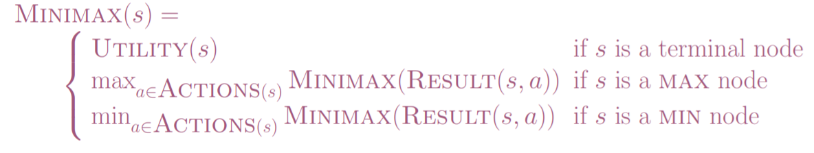
Minimax algorithm
Computes the optimal strategy for winning the game
Idea: propagate utility from leaves upwards (= Minimax)
MAX move should maximize utility, thus guaranteeing winning
MIN move can minimize utility, this guaranteeing not to lose
Optimal strategy determined by examining minimax value for each node.
Minimax decision for MAX: play a move at root that yields a successor node with the largest Minimax value – guarantees optimal result even if MIN plays optimaly, i.e., if MIN plays moves yielding a node with the smallest Minimax value
Minimax decision for MIN: play moves in response to the moves of MAX which minimize Minimax value

Slide 9
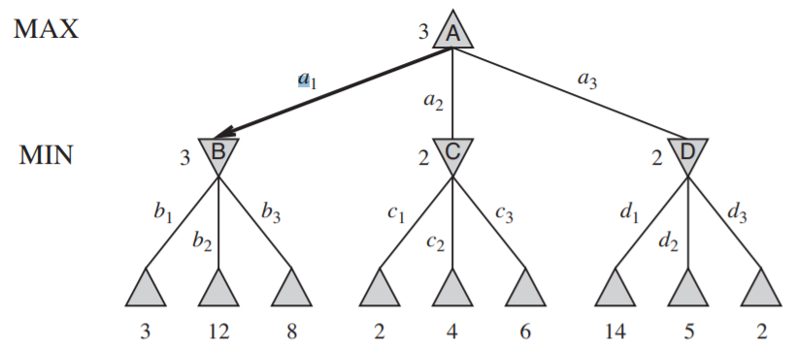
Minimax example: Simple 2-ply game
Playing games

Slide 10
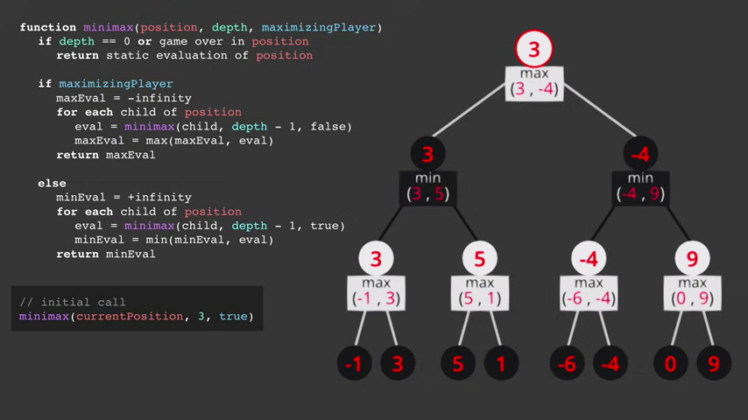
Playing games
https://youtu.be/l-hh51ncgDI

Slide 11
Properties of minimax
It amounts to DFS exploration of the game tree, therefore has similar
complexity as DFS
Complete?? Yes, if tree is finite (chess has specific rules for this)
Optimal?? Yes, even against an optimal opponent
Time complexity?? O(b^{m}) (need to calculate all possible moves at each level)
Space complexity?? O(bm) (need to remember all branches on each level)
Example: For chess, b ≈ 35, m ≈ 100 for “reasonable” games
⇒ exact solution completely infeasible
But do we need to explore every path?
Playing games

Slide 12
α–β pruning
Idea: Prune away branches that cannot possibly influence decision at root.
Consider node n in game tree
If player has a better choice m either at the parent of n or at any other choice further up, then n will never be reached in actual play
Prune n as soon as we have found out enough about n (by examining some of its descendants) to reach that conclusion.
For this, keep a range of posible values for each node.
α: value of best (highest) choice found so far at any choice point along path for MAX
β: value of best (lowest) choice found so far at any choice point along path for MIN
Sketch: update the values of α and β and prune remaining branches at node as soon as value of node is worse than the current α or β value for MAX or MIN, respectively.
Playing games

Slide 13
α–β pruning example
MAX
3
MIN
3
3
12 8
Playing games

Slide 14
α–β pruning example
MAX
3
MIN
3
2
X X
3
12 8 2
Playing games

Slide 15
α–β pruning example
MAX
3
MIN
3
2
14
X X
3
12 8 2
14
Playing games

Slide 16
α–β pruning example
MAX
3
MIN
3
2
14 5
X X
3
12 8 2
14 5
Playing games

Slide 17
α–β pruning example
MAX
3 3
MIN
3
2
14 5 2
X X
3
12 8 2
14 5
2
Playing games

Slide 18
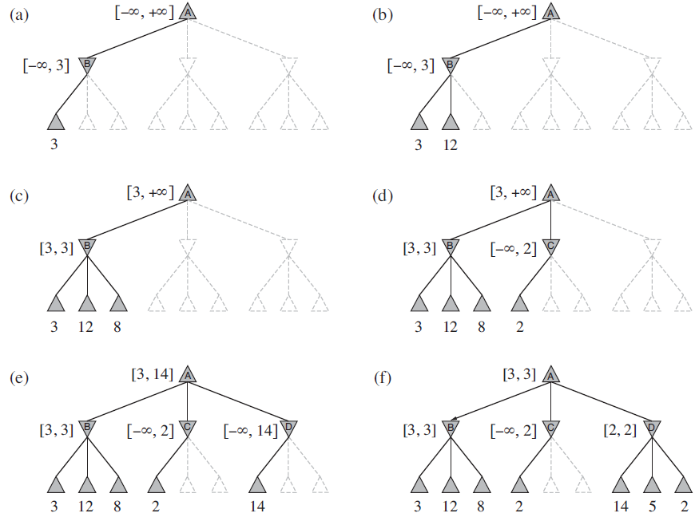

Slide 19
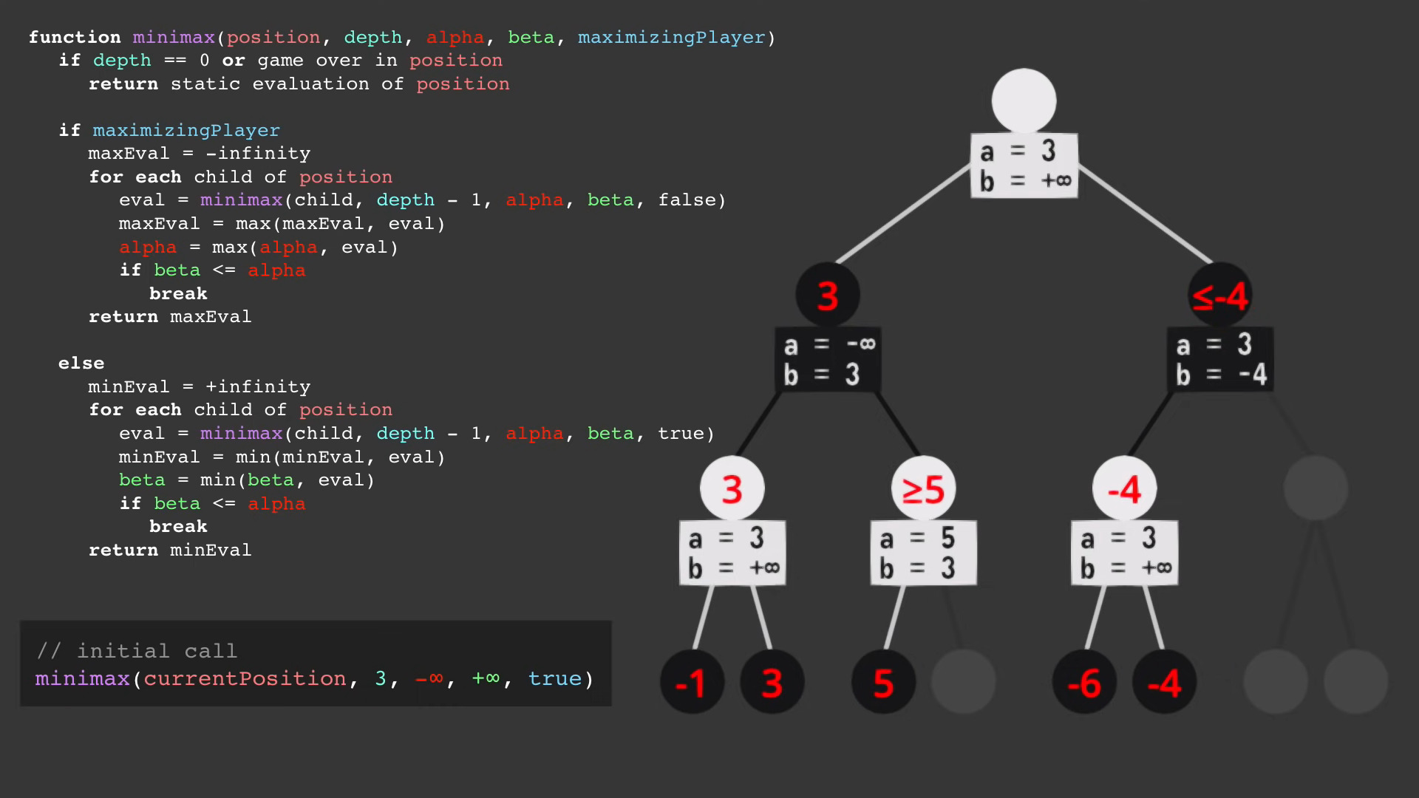

Slide 20
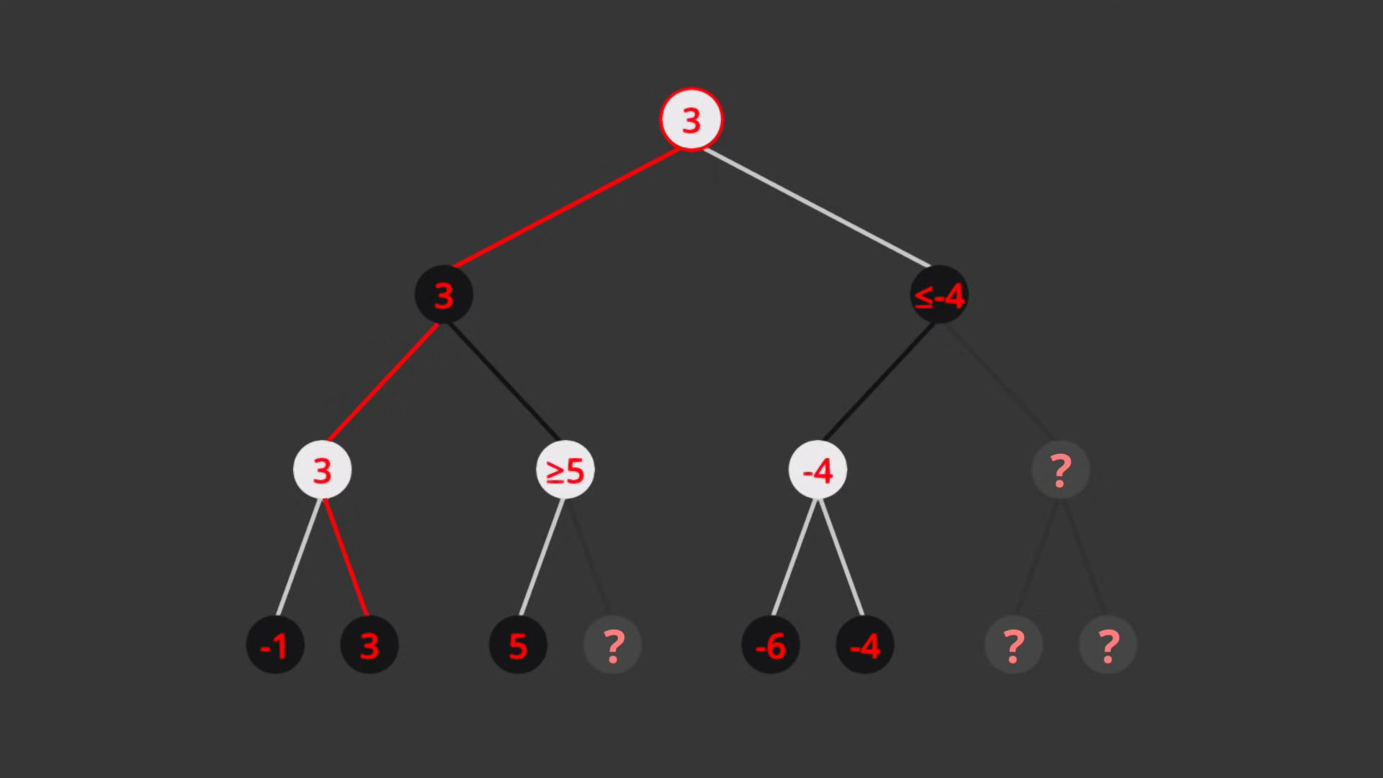

Slide 21
Properties of α–β
Pruning does not affect the final result
Good move ordering improves the effectiveness of pruning
Example: With “perfect ordering” we get time complexity = O(b^{m/2})
⇒ doubles solvable depth
Unfortunately, 35⁵⁰ still does not allow us to solve chess!
Pruning reduces the time for checking unnecessary moves and the memory for remembering unnecessary paths
How much precisely depends on the characteristics of the game tree
Binary trees
Ordered trees
Balanced trees
Playing games

Slide 22
Move ordering
MAX
3 3
MIN
3
2
14 5 2
X X
3
12 8 2
14 5
2
On the last branch, had we first examined the right-most move (resulting in 2), we could have avoided looking at moves leading to 14 and 5
⇒ Good move ordering significantly improves the search
How to order the nodes?
use hard-coded heuristics
learn form past moves
Playing games

Slide 23
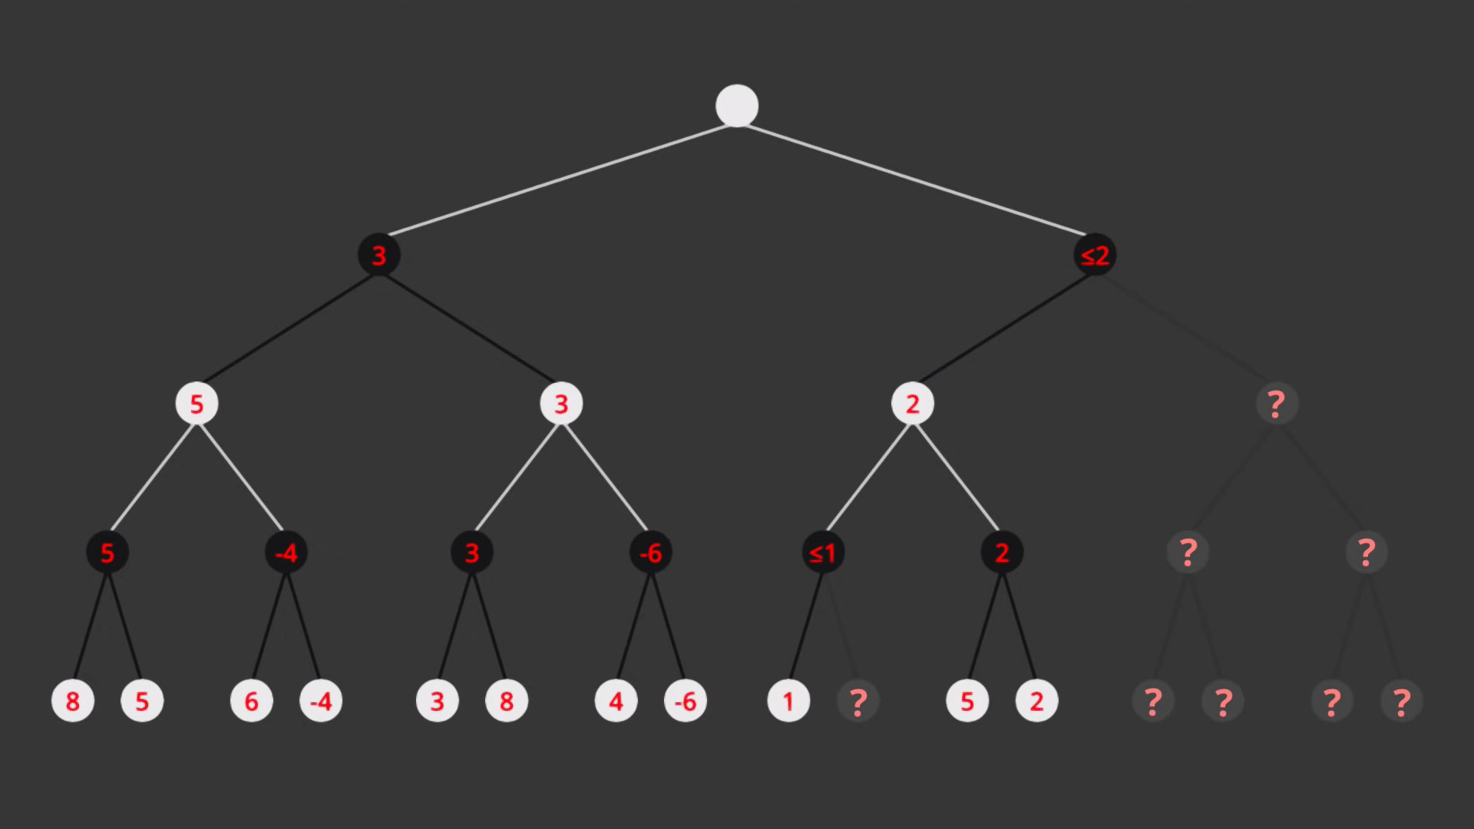
Properties of α–β
Playing games

Slide 24
Dealing with resource limits
Standard approach:
– use Cutoff-Test instead of Terminal-Test function to cut-off entire branches by maintaining values applicable to the entire branch rather than to the local path, e.g., depth limit
– use Eval (for estimating the value as needed) instead of Utility (for retrieving the value as stored) - i.e., evaluation function that estimates desirability of position
Example: Suppose we have 100 seconds and we explore 10⁴ nodes/second
⇒ 10⁶ nodes per move ≈ 35^{8/2} nodes in the search space
⇒ α–β reaches depth 8 (out of max depth 100) ⇒ pretty good chess program
Playing games

Slide 25
Exact values of Eval do not matter
MAX
MIN
1
2
1
20
1 2 2 4 1 20 20 400
Any monotonic transformation of Utility function preserves the optimality of the strategy
Eval(n) ≤ Eval(n ) if and only if Utility(n) ≤ Utility(n )
– usually not the case in practice
⇒ In deterministic games we just need to order states
Playing games

Slide 26
Practical evaluation functions
Eval should order terminal states as Utility
– otherwise we could miss wins even if we can explore entire game tree
Should reasonably approximate Utility on nonterminal states
– Computation should not take too long
Playing games

Slide 27
Defining evaluation functions
Common approach: define Eval as a linear combination of features
Eval(s) = w₁f₁(s) + w₂f₂(s) + . . . + w_{n}f_{n}(s)
Example: In chess f_{i} = the number of pieces on the board; w_{i} = the utility of the different pieces (the queen has the highest value, the pawn the lowest)
Eval(s) gives “good pawn structure”
Eval(s) gives “king safety”
Eval(s) gives “long corridors”
. . .
Alternative: We can also use nonlinear combinations of features
Example: In chess relations between figures and context matter
two pieces may be more useful together than each piece independently
a piece may have different utility at various states of the game
⇒ Requires huge amounts of expertise!
Playing games

Slide 28
Cutting off search strategies
Straightforward approach: a priori depth limit
Improvement: iterative deepening
increase depth until the time runs out
return the best move detected thus far
⇒ can be adapted to learn good move orderings
cut off at quiescent states (i.e., where Eval is unlikely to change rapidly)
Horizon effect: limit on search depth can postpone inevitable moves
Playing games

Slide 29
Search vs. lookup
Idea:
precompute a database of positions and the “best moves”
use lookup during play instead of search
often applicable to certain parts of the game
Chess openings were known for a century
The Oxford Companion to Chess lists 1,327 named openings
Endings can be precomputed by backwards search
start with a winning position and apply moves “backwards”
better performance in chess than humans!
solved checkers!
Playing games

Slide 30
Deterministic games in practice
Checkers: Chinook ended 40-year-reign of human world champion Marion Tinsley in 1994. Used an endgame database defining perfect play for all positions involving 8 or fewer pieces on the board, a total of 443,748,401,247 positions. Current version of Chinook cannot lose.
Chess: Deep Blue defeated human world champion Gary Kasparov in a six- game match in 1997. Deep Blue searches 200 million positions per second, uses very sophisticated evaluation, and undisclosed methods for extending some lines of search up to 40 ply.
Othello: human champions refuse to compete against computers, who are too good.
Go: human champions refuse to compete against computers, who are too bad. In Go, b > 300, so most programs use pattern knowledge bases to suggest plausible moves.
Playing games

Slide 31

Nondeterministic games: backgammon
0 1 2 3 4
5
6
7 8 9 10 11 12
25 24 23 22 21 20 19 18 17 16 15 14 13
Playing games

Slide 32
Nondeterministic games in general
Chance is introduced by different methods: tossing a coin, throwing dices, shuffling of cards . . .
Game tree in such cases includes chance nodes
⇒ have outgoing edges labeled with probabilities
MAX
CHANCE
3
−1
0.5
0.5
0.5
0.5
MIN
2
4
0
−2
2 4 7 4 6 0 5 −2
Playing games

Slide 33
Nondeterministic games in general
We still want to pick the move that leads to the best position, but
The resulting positions do not have definite minimax values !
we can only calculate the expected value, where expectation is taken over all possible dice rolls.
Idea to extend minimax:
evaluate terminal, MIN and MAX nodes as before
evaluate chance nodes by taking weighted average of values resulting from all possible dice rolls.
Playing games

Slide 34
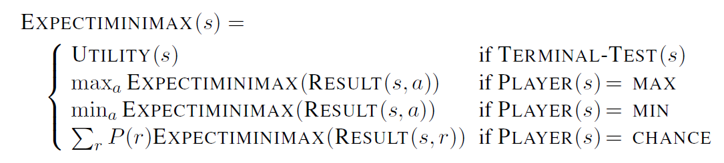
Expectiminimax algorithm
Similar to Minimax, but also handles chance nodes; yields perfect play (maximises expected values)
Playing games

Slide 35


Pruning in nondeterministic game trees
A version of α-β pruning is possible:
[ −∞, + ∞ ]
0.5
[ − ∞ , + ∞ ]
0.5
0.5
0.5
[ − ∞ , + ∞ ]
[ − ∞ , + ∞ ]
[ − ∞ , + ∞ ]
[ − ∞ , + ∞ ]
Playing games

Slide 36

Pruning in nondeterministic game trees
A version of α-β pruning is possible:
[ − ∞ , + ∞ ]
0.5
[ − ∞ , + ∞ ]
0.5
0.5
0.5
[ − ∞ , 2 ]
[ − ∞ , + ∞ ]
[ − ∞ , + ∞ ]
[ − ∞ , + ∞ ]
2
Playing games

Slide 37
Pruning in nondeterministic game trees
A version of α-β pruning is possible:
[ −∞ , +∞ ]
0.5
[ − ∞ , + ∞ ]
0.5
0.5
0.5
[ 2 , 2 ]
[ − ∞ , + ∞ ]
[ − ∞ , + ∞ ]
[ − ∞ , + ∞ ]
2
2
Playing games

Slide 38
Pruning in nondeterministic game trees
A version of α-β pruning is possible:
[ −∞ , 2 ]
0.5
[ −∞ , +∞ ]
0.5
0.5
0.5
[ 2 , 2 ]
[ −∞ , 2 ]
[ −∞ , +∞ ]
[ −∞ , +∞ ]
2
2
2
Playing games

Slide 39
Pruning in nondeterministic game trees
A version of α-β pruning is possible:
[ 1.5 , 1.5 ]
0.5
[ −∞ , +∞ ]
0.5
0.5
0.5
[ 2 , 2 ]
[ 1 , 1 ]
[ −∞ , +∞ ]
[ −∞ , +∞ ]
2
2
2
1
Playing games

Slide 40
Pruning in nondeterministic game trees
A version of α-β pruning is possible:
[ 1.5, 1.5 ]
0.5
[ − ∞, + ∞ ]
0.5
0.5
0.5
[ 2, 2 ]
[ 1, 1 ]
[ − ∞ , 0 ]
[ − ∞, + ∞ ]
2
2
2
1
0
Playing games

Slide 41
Pruning in nondeterministic game trees
A version of α-β pruning is possible:
[ 1.5 , 1.5 ]
0.5
[ −∞ , + ∞]
0.5
0.5
0.5
[ 2 , 2 ]
[ 1 , 1 ]
[ 0 , 0 ]
[ −∞ , + ∞]
2
2
2
1
0
1
Playing games

Slide 42

Pruning in nondeterministic game trees
A version of α-β pruning is possible:
[ 1.5
, 1.5 ]
[ −∞, 0.5 ]
0.5
0.5
0.5
0.5
[ 2 , 2 ]
[ 1 , 1 ]
[ 0 , 0 ]
∞
[ − , 1 ]
2
2
2
1
0
1
1
Playing games

Slide 43
Exact values of Eval DO matter
MAX
DICE
2.1
1.3
21
40.9
.9
.1
.9
.1
.9
.1
.9
.1
MIN
2
3
1
4
20
30
1
400
2 2 3 3 1 1 4 4
20 20 30 30 1 1 400 400
Behavior is preserved only by positive linear transformation of Utility
Hence Eval should be proportional to the expected payoff
Playing games

Slide 44
Nondeterministic games in practice
Complexity of expectiminimax: O(b^{m}n^{m})
b: the branching factor for moves
n: the number of rolls
m: the maximum depth of the tree
⇒ dice rolls increase the branching factor:
Example: In backgammon we have 21 possible rolls with 2 dice; for 20 legal moves per roll on average (can be 6,000 for 1-1 roll!) and depth 4 of the tree we have 1.2 × 10⁹
As depth increases, probability of reaching a given node shrinks
⇒ value of lookahead is diminished and α–β pruning is much less effective
Example: TDGammon uses only depth-2 search but with very good Eval ≈ world-champion level
Playing games

Slide 45
Monte Carlo simulation
Based on simulation, calculates the probabilities of good moves by running multiple games; applicable to both deterministic and nondeterministic games
Determine the next move from position P :
play a random game starting from P (= playout)
record for the initial move the result of the game (win/loss/draw)
repeat until no more time
play the initial move that lead to wins most often
Playout types:
truly random—each move is equally likely
move probability is weighted based on utility
Surprisingly good results on simple games
constant space complexity (no need to store search tree)
Monte Carlo tree search: probabilistic simulation + search
eliminates choice nodes on nondeterministic games
Playing games

Slide 46
Summary
Games illustrate several important points about AI:
perfection is unattainable ⇒ must approximate
good idea to think about what to think about
uncertainty constrains the assignment of values to states
optimal decisions depend on information state, not real state
Games are to AI as grand prix racing is to automobile design
Playing games

